Slide 1
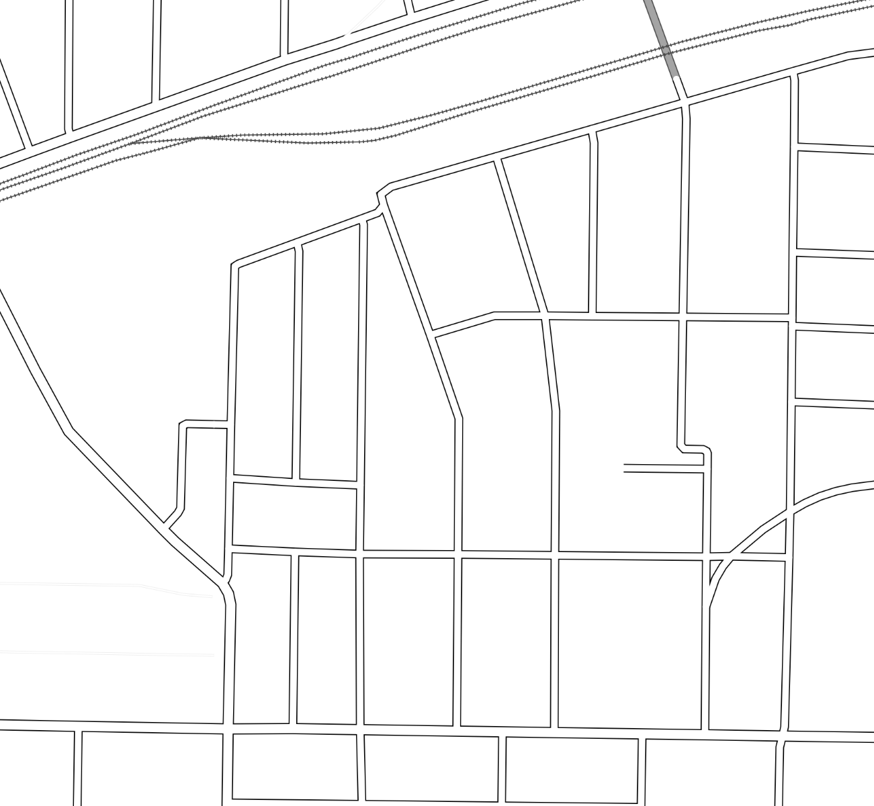
Cabbagetown Streets Survey
April 4, 2016
CNIA Transportation Committee
Richard Joyce

Slide 2
I _______ CABBAGETOWN.
 | Live In | Visit Businesses In | Work In | Travel Through
C’town | 106 | 29 | 18 | 19
R’town | 10 | 30 | 1 | 36
Grant Park |  | 13 |  | 17
Other |  | 13 | 1 | 10
Total | 116 | 85 | 20 | 82
Other neighborhoods:
Edgewood Glenwood Park
Inman Park Lower/Old Fourth Ward
Midtown Ormewood Park
Peoplestown Kirkwood
EAV
n=187

Slide 3
Cabbageheads only: Residential Parking Zones
1=Strongly Disagree
2=Disagree
3=Neutral
4=Agree
5=Strongly Agree
Row Labels | Institute a Residential Parking Permit Zone
Cabbagetown | 2.84
While Cabbagetown as a whole is not greatly in favor of a Residential Parking Zone, there is considerable interest from residents who live on streets near Carroll Street, including Savannah, Gaskill, Pickett, and Berean. Those who live further from Carroll generally do not see the need yet, but anticipate the Beltline and Memorial Drive developments will bring much more demand for on-street space.
I hate leaving home sometimes because I know there will be no parking when I get back. I hate carrying all of [my] groceries from a couple of streets over.
People park on Berean Ave and walk to Milltown and Carol Street Bakery taking up the [residential] parking. I have followed them to see where they are going!
This would be very detrimental to local businesses…
Not at all in favor. Reeks of in-town city elitism.
This will likely become an issue once the Beltline expands.
…important to address this now before Memorial Dr explodes…
I like to host events - family for holidays, etc. - and I'm afraid permits would make those events much more difficult.
I'd really like to see something other than parking at the church lot at the corner of Picket and Savannah.
I think [residential parking zones] discourage people from driving to the neighborhood, which is just fine by me.
ParkAtlanta is the devil…
(and other variations)

Slide 4
Parking
Row Labels | Denote commercial and/or short term loading zones This may sacrifice general parking space for a more harmonious mixed-use on-street space. | $2 for self-parking at a Cabbagetown business There isn't such an option now, but what if a neighborhood-scale development brings a large parking garage that's also available to the public. | Add ride-sharing pickup zones Denote specific areas as late-night / weekend no parking zones, to be used only for ridesharing drivers (Uber/Lyft/etc.) to drop off and pick up their passengers.
Cabbagetown | 2.95 | 2.58 | 2.76
Reynoldstown | 3.42 | 2.38 | 3.17
Grant Park | 3.11 | 3.39 | 3.22
Other | 3.23 | 3.69 | 3.54
Grand Total | 3.11 | 2.69 | 2.96
1=Strongly Disagree
2=Disagree
3=Neutral
4=Agree
5=Strongly Agree
Savannah St should only be residential parking.
There isn't enough for residents as it is, especially those without driveways, painting lines to make the most use of space available would be helpful on some streets
We selected Cabbagetown as our home because of its vibe. Enforcing all of these rules makes it feel like a snooty suburb, not city living.
It is what it is. I walk so I don't have to park. That is one of the reasons I moved here.
I'm fine with the parking situation. I walk or bike and I wish more would do the same!
Promote other modes of transportation to and from Cabbagetown.
Concerns: delivery trucks parking and blocking the way.

Slide 5
Traffic Flow
Row Labels | Eliminate parking at/near bottlenecks of narrow streets Bollards, benches, bicycle parking, on the street near corners could prevent parking, but allow enough space for passing. More expensive ideas include curb bulb-outs at corners or large planters. | Convert 2-way streets to 1-way to improve vehicle flow Where our narrow streets can't accommodate parking and two directions of traffic, we could make streets like Carroll, Iswald, Estoria, or Tye one-way. | Convert one-way streets to two-way to slow traffic Generally increase accessibility at the expense of vehicle speed; typically also reduces parking
Cabbagetown | 3.40 | 3.18 | 2.06
Reynoldstown | 4.19 | 4.02 | 2.27
Grant Park | 3.83 | 3.82 | 2.17
Other | 4.38 | 4.08 | 2.46
Grand Total | 3.71 | 3.52 | 2.15
1=Strongly Disagree
2=Disagree
3=Neutral
4=Agree
5=Strongly Agree
Carroll Street should be one-way!
If you make Carroll one way then people will just fly down it. The two way street, while a mess, keeps traffic slower.
Any realistic solution must include input from the businesses located throughout Cabbagetown.
Krog tunnel gets so backed up.
People have zero concept of right of way. Maybe we can find a way to educate people instead of overhauling what's been working for this long
People…go the wrong way on one-way streets.
As Memorial gets denser there will be more people using your neighborhoods as cut through. They will be frustrated and dangerous.

Slide 6
Traffic Speed
Row Labels | Add stop signs to slow traffic Whether to thoroughfares or side streets, this also asserts corner parking buffers and allows service vehicles extra space for turning. | Stagger parking to opposite sides of the street to slow traffic Move parking to sides of the street without driveways, allowing for maximum on-street parking space | Add traffic calming devices Speed humps, chicanes, and other objects help slow traffic, but can sometimes take away on-street parking.
Cabbagetown | 3.23 | 3.19 | 2.80
Reynoldstown | 3.88 | 3.56 | 3.24
Grant Park | 3.56 | 3.94 | 2.50
Other | 3.62 | 4.00 | 2.42
Grand Total | 3.46 | 3.41 | 2.87
1=Strongly Disagree
2=Disagree
3=Neutral
4=Agree
5=Strongly Agree
The most dangerous street is Wiley...do something to slow traffic down
I would love to see traffic calming devices on Pearl. We've seen several wrecks @ Kirkwood because of people going too fast down Pearl.
People drive too fast in general and go the wrong way on one-way streets.
People drive too fast on Wylie…and don't watch for pedestrians.
People FLY down Estoria and it's very unsafe.
Speed humps on South Powell please.

